Slide 1
GENERATION OF PHOTOREALISTIC IMAGE USING GAN AND SPADE
MANGALORE INSTITUTE OF TECHNOLOGY AND ENGINEERING
(An ISO 9001:2015 Certified Institution)
DEPARTMENT OF COMPUTER SCIENCE AND ENGINEERING
(NBA Accredited)
UNDER THE GUIDANCE OF
DR. VENKATRAMANA BHAT P
Professor & Head of Department
Dept of CSE
TEAM MEMBERS
Adarsh Revankar • Akshaya M • Shubham Dogra

Slide 2
Outline
Abstract
Introduction
Problem Statement
Literature Review
Methodology
Implementation Details
Proposed Requirements
Possible Outcomes
References

Slide 3
Abstract
A tool for the synthesis of photorealistic images.
Input is taken as semantic layout and uses GAN with the SPADE layer to generate a visually appealing image.
GAN is a special neural network with the ability of image-to-image transformation.
SPADE layer retains the information contained in the input semantic masks, which helps in the production of a realistic image.
CNN is used as a generator as well as a discriminator, to produce a sample (output image) and govern the dissimilarity (error) concerning the training set respectively.

Slide 4


Introduction
Conditional image synthesis refers to the task of generating photorealistic images conditioning on certain input data.
Major work is to compute the output image by stitching pieces from a single image or using an image collection.

Slide 5




Problem Statement
Materialistic realization of imagination is quite difficult. Eg: Speech, Text.
Humans struggle to produce a replica of their imagination productively.
Challenge to scale supervised neural networks.
Suboptimal Normalization Layer.

Slide 6


Literature Review
Dataset: COCO Stuff
Microsoft Common Objects in Context
Complex everyday scenes of common objects in their natural context.
Object highlighting, labeling, and classification into 91 object types
Model: GAN
Generative Adversarial Network
Generative adversarial nets were introduced as a novel way to train a generative model.
Contains Generative Model (G) that captures the data distribution, and a Discriminative Model (D) that estimates the probability that a sample came from the training data rather than G.

Slide 7
Methodology
Input
GAN
Semantic Layout
Pre-processing
Discriminator
Generator
Style Image
Conv
ReLU
SPADE
Photo Realistic Image

Slide 8

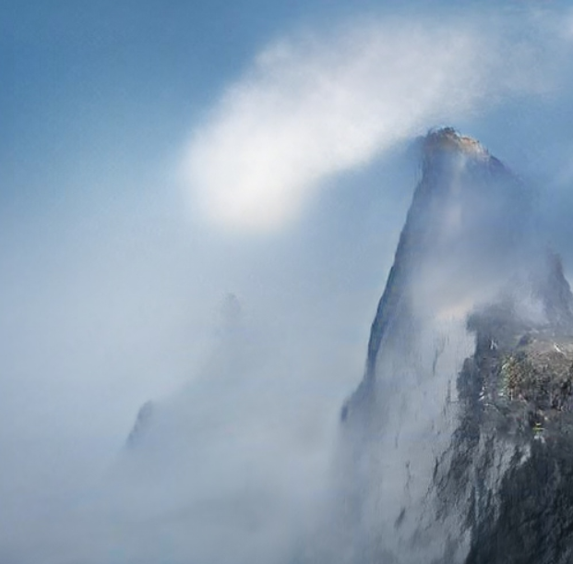
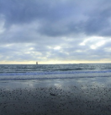
Model
Segmentation Map
+
Realistic Image
Style Image

Slide 9

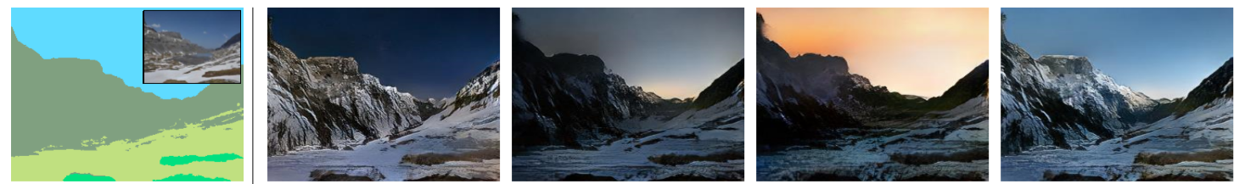
Implementation Details
System includes a GAN. A specific modification of GAN with SPADE synthesizes visually effective images over suboptimal neural networks such as pix2pixHD, CRN, or SIMS as shown below.
Label
CRN
SIMS
pix2pixHD
SPADE

Slide 10

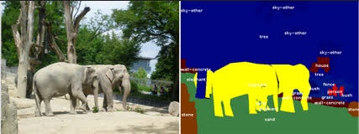
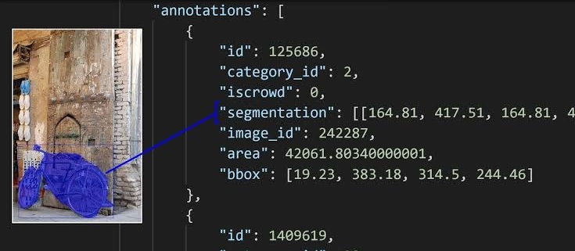
Dataset
1
GAN require a large number of images with Image Semantics Layout.
COCO Stuff Dataset
Available well classified datasets:
COCO Stuff Dataset
ADE20K Dataset
Cityscape
COCO API
181K Train + 5K Val Images
91 Categorical Classified Images
Original Image
Annotation .json file structure
Segmentation Map

Slide 11
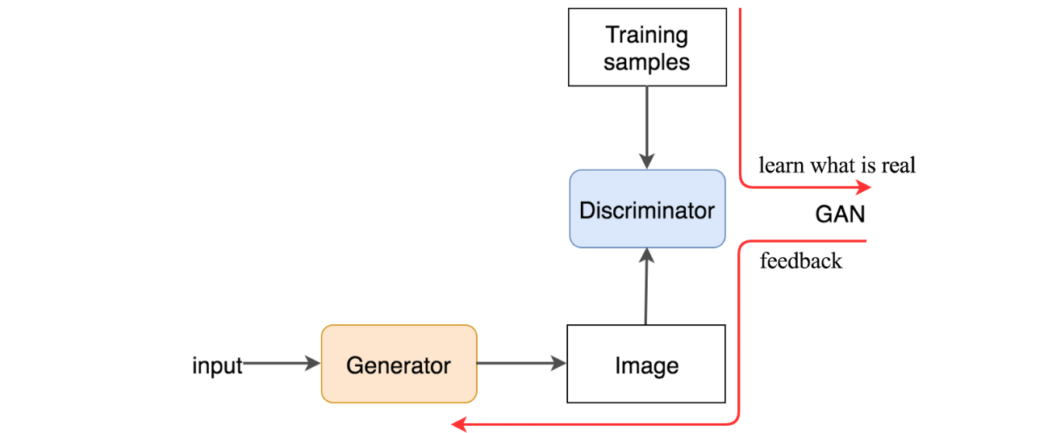

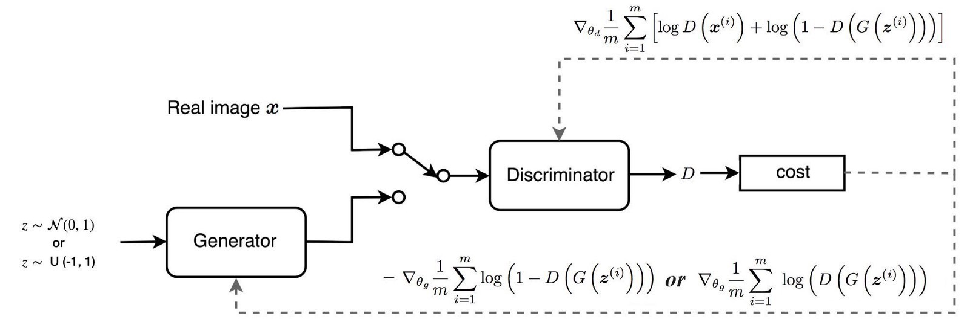



GAN
2
Generative Adversarial Network
Usage
Generate data from scratch
Example : Right side image is created using Horse on left side using Reinforcement Learning
Right side image created by GAN
Components
Generator
VS
Discriminator

Slide 12


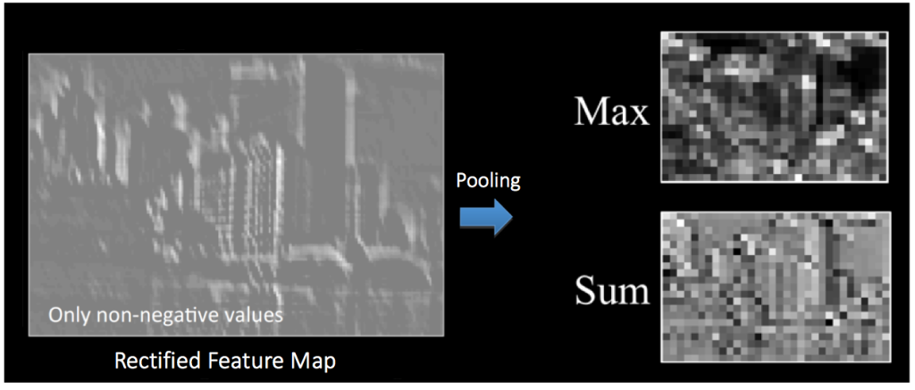
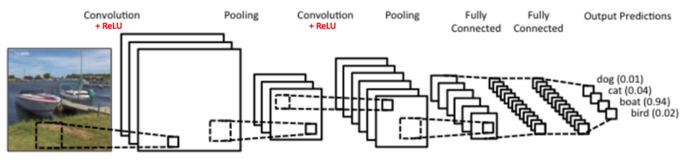
CNN
3
Convolutional Neural Network
Usage
Operations
A artificial neural network which is configured to identifying faces, objects and traffic signs.
Convolution
Non Linearity (ReLU)
Pooling or Sub Sampling
Classification (Fully Connected Layer)
Figure: Convolution Operation
Figure: A simple ConvNet
Figure: Pooling

Slide 13
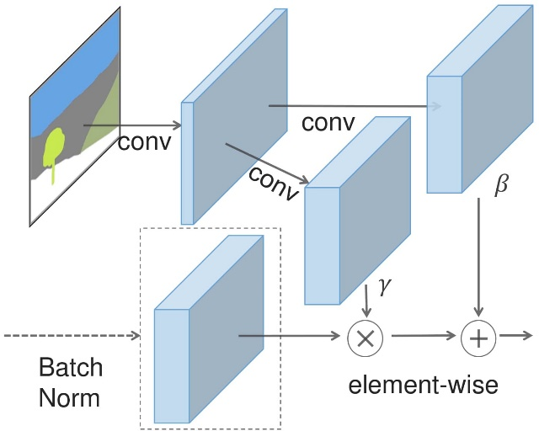
SPADE
4
Spatially Adaptive (De)Normalization
Usage
Preserves the segmentation map information compared to other normalization layers like Instance Norm.
Working
A Conv layer applied to the resized seg map to extract the features.
Normalize our feature map using BatchNorm
Denormalize using the values we get from the seg map.

Slide 14
Proposed Requirements
1
HARDWARE REQUIREMENTS
CPU
GPU
RAM
I/O
14634
PassMark Score <
Eg: i7-7800x
13656
PassMark Score or more
Eg: nVidia Titan X 12GB
16 GB
DDR4
2400MHz
Ink
or
Mouse
2
SOFTWARE REQUIREMENTS
Python Env
Anaconda Libraries
Tensorflow / PyTorch Library
Android (OpenGL ES) or Web Interfacing (WebGL)

Slide 15



Possible Outcomes
Generation of photorealistic images.
Improved communication by better representation of ideas.
User friendly interface to give semantic Input.

Slide 16
References
Semantic Image Synthesis with Spatially-Adaptive Normalization - Taesung Park, Ming-Yu Liu, Ting-Chun Wang, Jun-Yan Zhu. https://arxiv.org/pdf/1903.07291
Conditional Generative Adversarial Nets - Mehdi Mirza, Simon Osindero. https://arxiv.org/pdf/1411.1784.pdf
Understanding of a Convolutional Neural Network https://ieeexplore.ieee.org/document/8308186
Microsoft COCO: Common Objects in Context https://arxiv.org/pdf/1405.0312.pdf

